Slide 1
Facebook – Exploratory Data Analysis
By Data Diggers International

Slide 2
Team Info

Slide 3
Domain and Topic of Project

Slide 4
- pseudo_facebook.tsv
About the Data I
# of Records | 99,003
# of Columns | 15
Srl# | Column Description | Data Type
1 | dob_year_dob_month_dob_day | datetime64[ns]
2 | userid | int64
3 | age | int64
4 | gender | object
5 | tenure | float64
6 | friend_count | int64
7 | friendships_initiated | int64
8 | likes | int64
9 | likes_received | int64
10 | mobile_likes | int64
11 | mobile_likes_received | int64
12 | www_likes | int64
13 | www_likes_received | int64
14 | tenure_mnth | float64
15 | tenure_yrs | float64

Slide 5
- pseudo_facebook.tsv
About the Data II
Columns | count | mean | std | min | 25% | 50% | 75% | max
age | 99003 | 37.28 | 22.59 | 13 | 20 | 28 | 50 | 113
tenure | 99001 | 537.89 | 457.65 | 0 | 226 | 412 | 675 | 3139
friend_count | 99003 | 196.35 | 387.30 | 0 | 31 | 82 | 206 | 4923
friendships_initiated | 99003 | 107.45 | 188.79 | 0 | 17 | 46 | 117 | 4144
likes | 99003 | 156.08 | 572.28 | 0 | 1 | 11 | 81 | 25111
likes_received | 99003 | 142.69 | 1387.92 | 0 | 1 | 8 | 59 | 261197
mobile_likes | 99003 | 106.12 | 445.25 | 0 | 0 | 4 | 46 | 25111
mobile_likes_received | 99003 | 84.12 | 839.89 | 0 | 0 | 4 | 33 | 138561
www_likes | 99003 | 49.96 | 285.56 | 0 | 0 | 0 | 7 | 14865
www_likes_received | 99003 | 58.57 | 601.42 | 0 | 0 | 2 | 20 | 129953
tenure_mnth | 99001 | 1.47 | 1.25 | 0 | 0.62 | 1.13 | 1.85 | 8.6
tenure_yrs | 99001 | 2.00 | 1.26 | 0 | 1 | 2 | 2 | 9

Slide 6
Basic Analysis

Slide 7
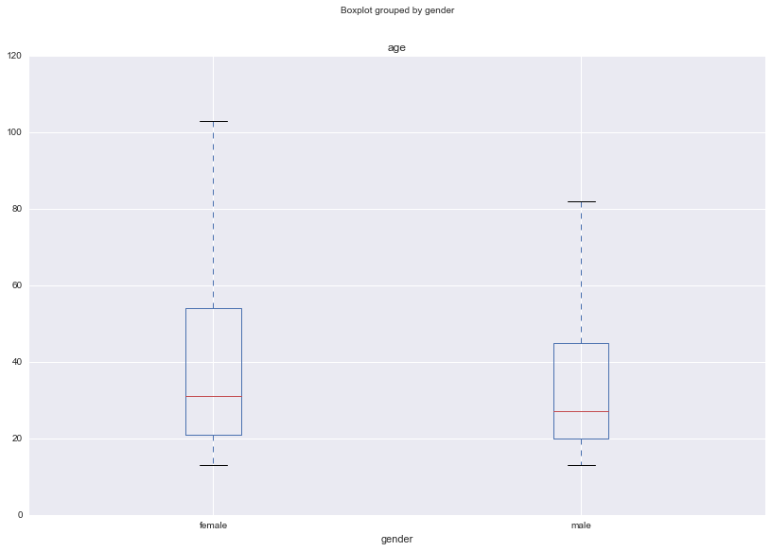
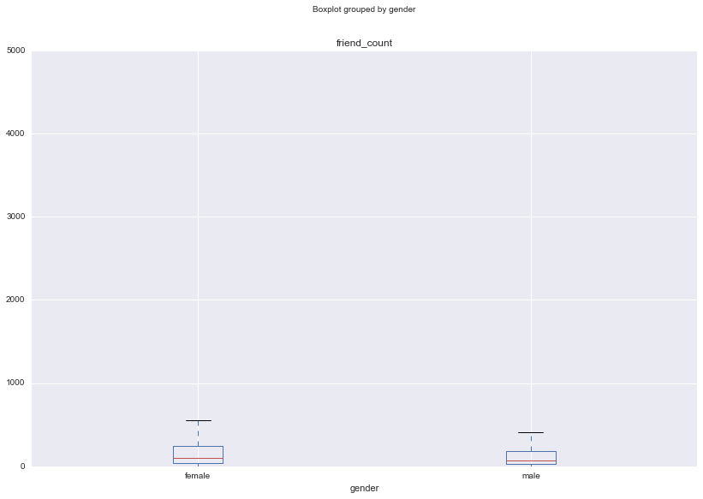
User Age-wise Gender Analysis
Basic Analysis I
Observation:
Average Female Age in FB is more than that of Male
Female Users has much larger Range of Age
Observation:
<<<< >>>
Dieago or Vasu can you do something about the Y-Axis Scale of this .

Slide 8
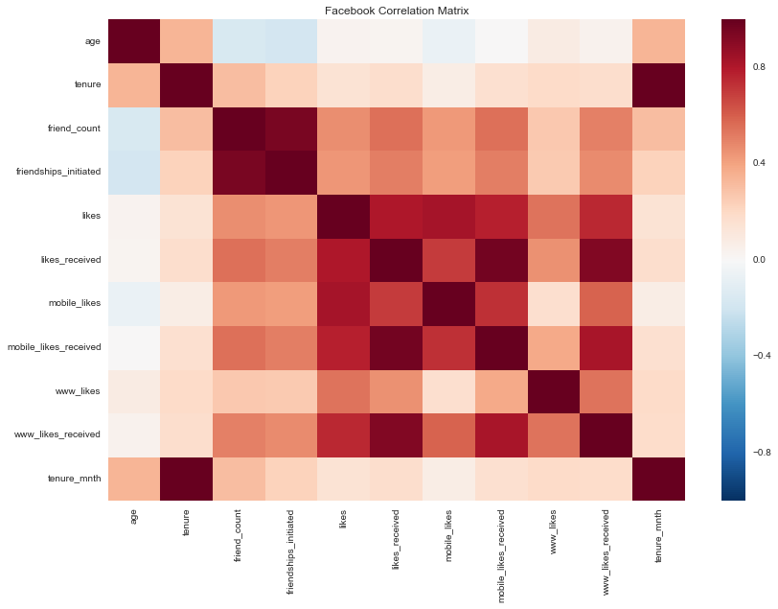
Basic Correlation Matrix
Basic Analysis II
Strong Correlations
“Friendship Initiated “and “Friend Count”
“Likes” and “Likes Received”

Slide 9
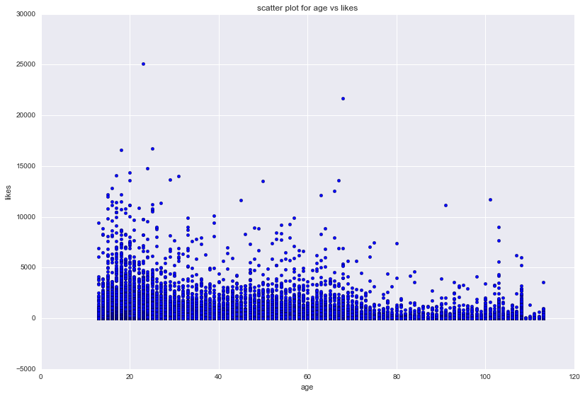
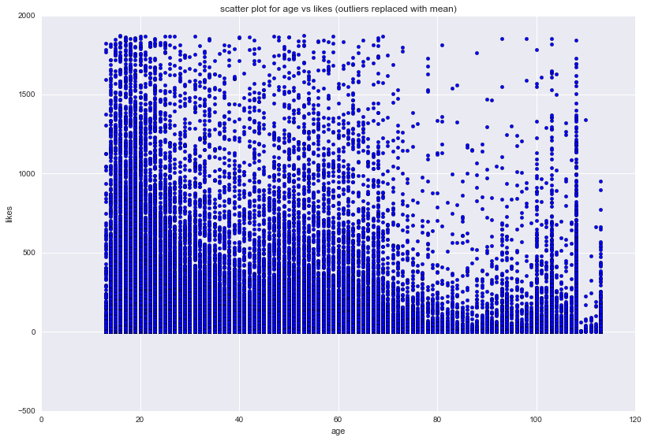
Facebook User Activity – By Age
Basic Analysis III
Likes Activity by Age of Facebook User
Observation:
Activity Level is highest with the Millennials
Activity with FB User who are more than 100+ Years as well. Leads to doubt if there is some Issue with the data
Likes Activity by Age of Facebook User without Outliers
Observation:
Activity with FB User who are more than 100+ Years continues to be seen as Strong even for this case

Slide 10
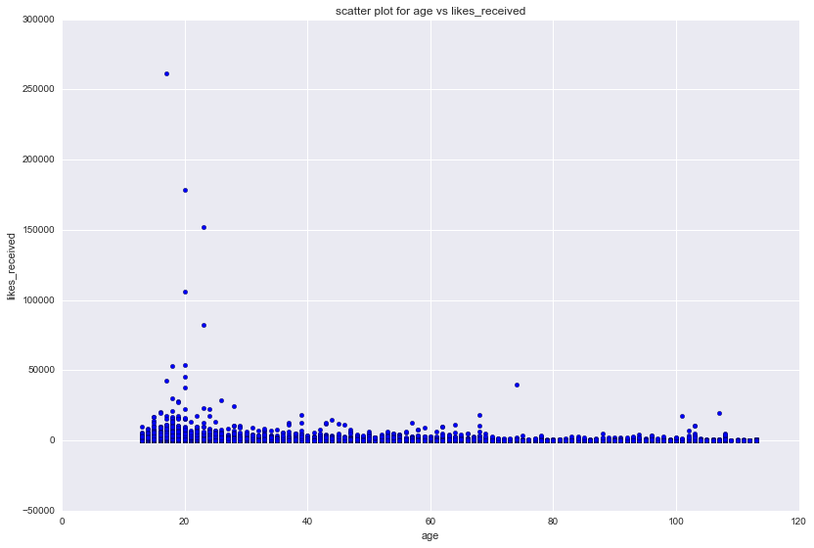
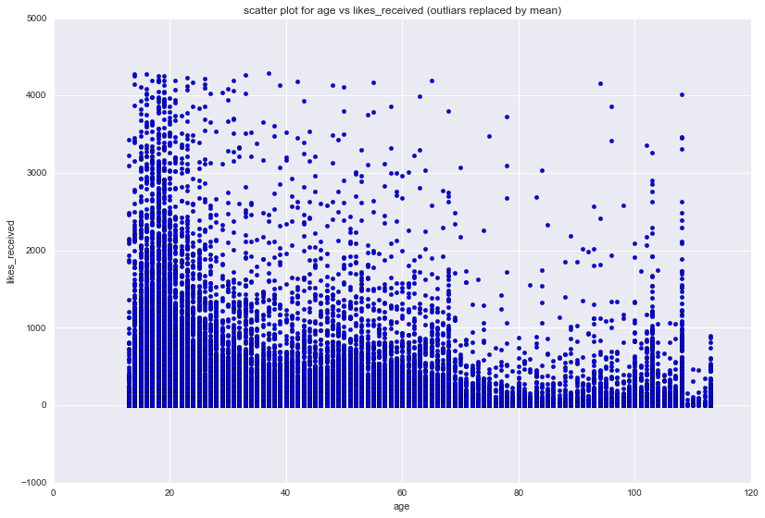
Facebook User Reaction – By Age
Basic Analysis IV
Likes Received by Age of Facebook User
Observation:
Activity Level is highest with the Millennials
Outliers makes the Data Visualization difficult
Likes Received by Age of Facebook User without Outliers
Observation:
Likes Received by FB User who are more than 100+ Years continues to be seen as Strong even for this case

Slide 11
Business Questions

Slide 12
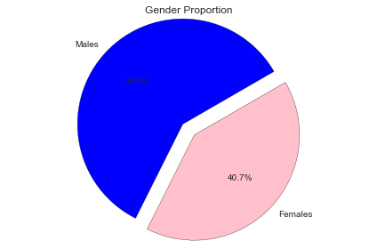
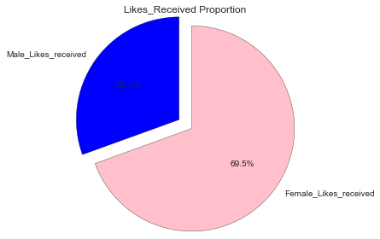
Q1. Does Gender and Age of User effect their Likeability in FB?
Male FB Users are still more than Female FB User by almost 9%
Histogram of Age-wise Distribution of Average likes for
Male and Females
< Dieago can you please provide?>

Slide 13
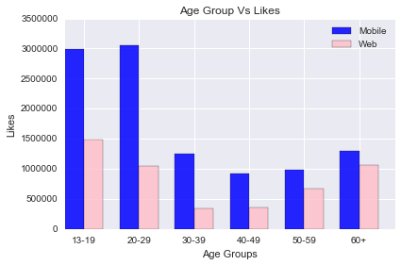
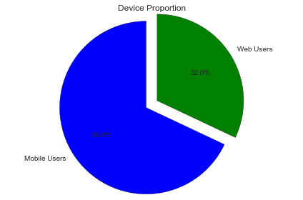
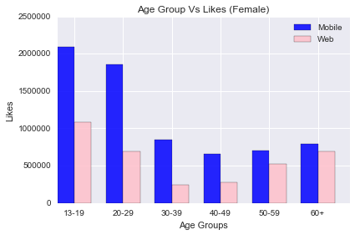
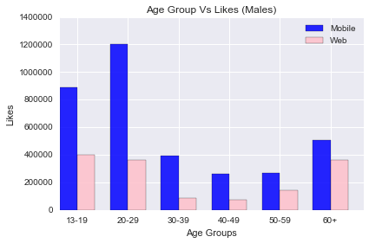
Q2. What is the Device Usage pattern by FB Users over Age Group?
FB Usage on Mobile Device is more than Double that thru browser (laptop/desktop)
Observation:
Usage of Mobile Device to Access Social Media is Significantly High with Age Group upto 50 years.
Even with 60+ years usage of mobile device is slightly higher than www
As a Percentage Share the 30-39 years accesses the most with the mobile device

Slide 14
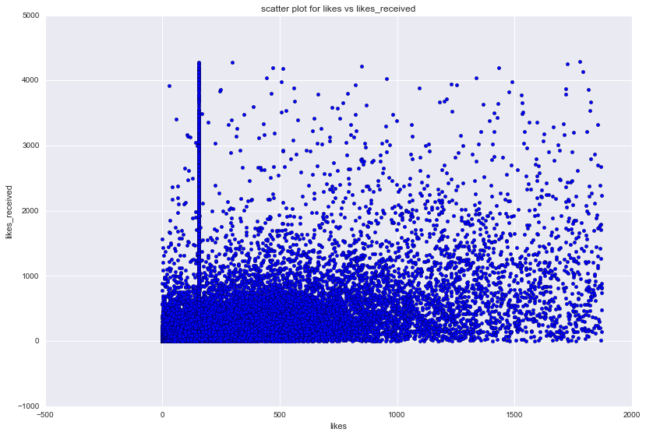
Q3. What is the Relationship between “Likes” and “Likes Received”
Likes Vs Likes Received
Observation:
Liking More things does NOT mean you will be liked back more
Does Female gets more Like than Males?
Need Scatter Plot for Female
< Dieago can you please provide?>
Need Scatter Plot for Male
< Dieago can you please provide?>

Slide 15
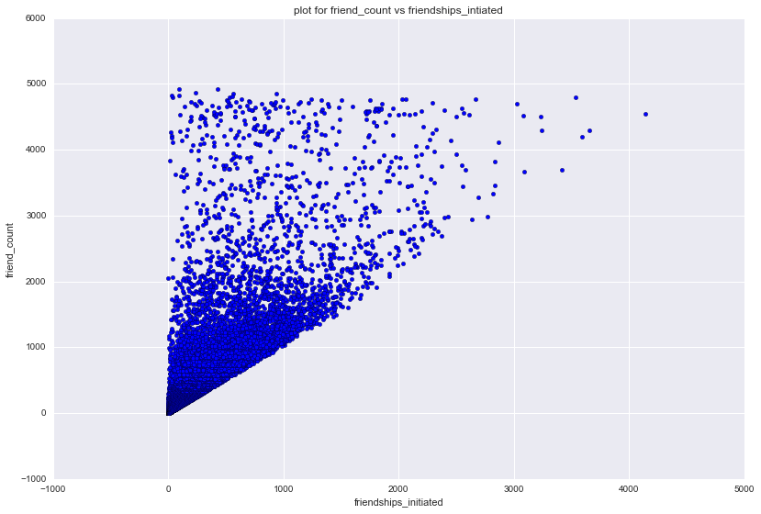
Q4. How are “Friend Count” and “Friendship Initiated” Related?
Observation:
Most Users Have more Friend’s Than Friendship Initiated
Does Female gets more Friend’s than Friendship Initiated?
Need Scatter Plot for Female
< Dieago can you please provide?>
Need Scatter Plot for Male
< Dieago can you please provide?>

Slide 16
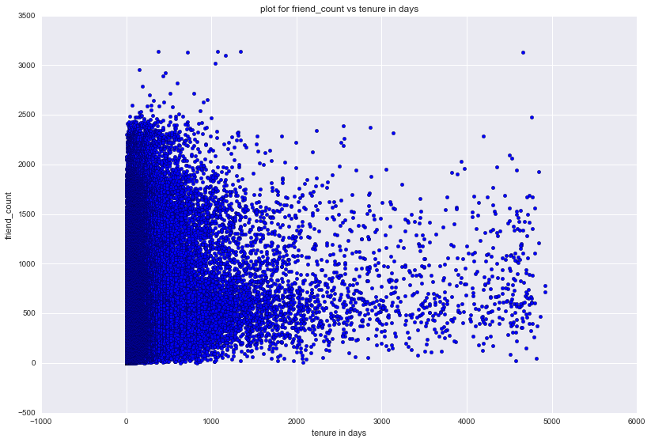
Q5. What is the Significance of FB Age w.r.t. “Friend Count”
FB Age is the number of Year or Month in FB.
Observation:
More FB Age does not translate to More Friends. Rate of Increase in Network diminishes over time

Slide 17
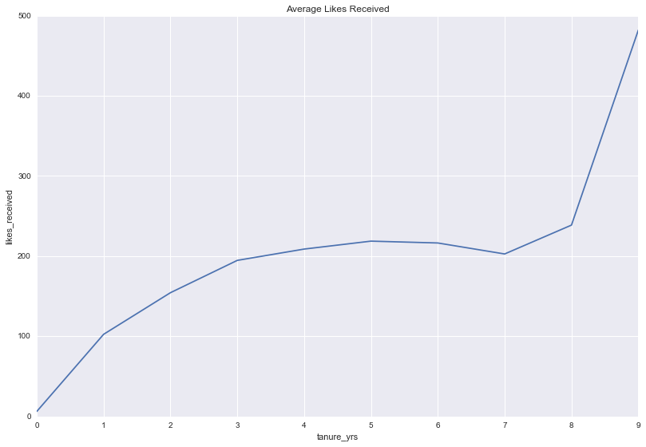
Q6. What is the Significance of FB Age w.r.t. “Likes Received”
FB Age is the number of year or Month
Observation:
Likes Received - Average number of Likes Received by User is directly proportional to FB Age.
Oldest Account between 8 and 9 Years old has the Highest Average.
Can we plot the Above Graph based on “Likes Received” when Grouped by FB Age in Month instead of year?
< Dieago can you please help with this?>

Slide 18
Q6. What is the Significance of FB Age w.r.t. “Likes Received”
Can we plot the Graph based on “Likes Received” when Grouped by FB Age in Month for Female?
< Dieago can you please help with this?>
FB Age is the number of Year or Month
Observation:
Likes Received - Average number of Likes Received by User is directly proportional to FB Age.
Oldest Account between 8 and 9 Years has the Highest Average.
Can we plot the Graph based on “Likes Received” when Grouped by FB Age in Month for Male?
< Dieago can you please help with this?>

Slide 19
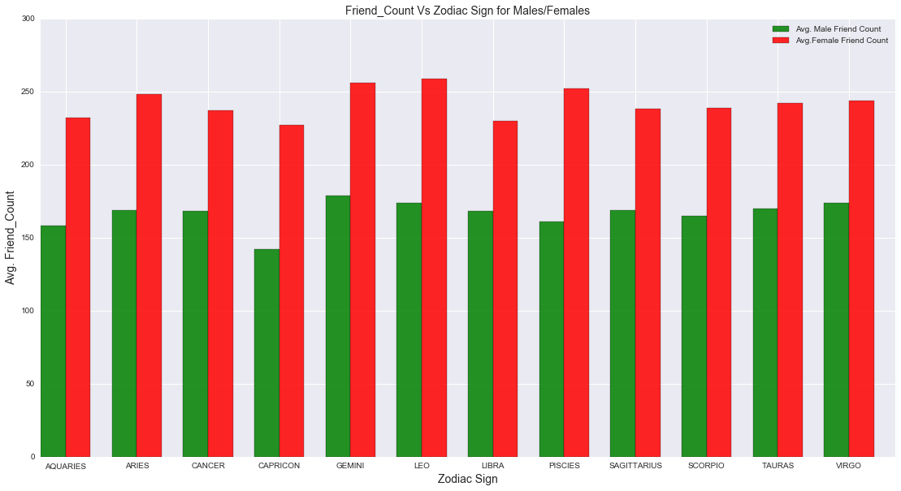
Q7. What has Stars to do about ones Social Likeability?
No Significant outlier on Friend Count for the various Zodiac Signs

Slide 20
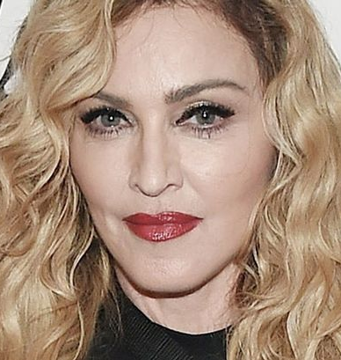
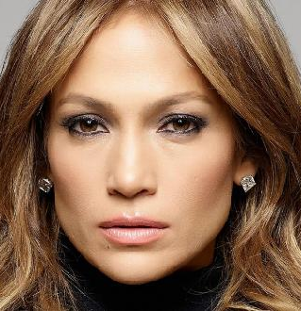
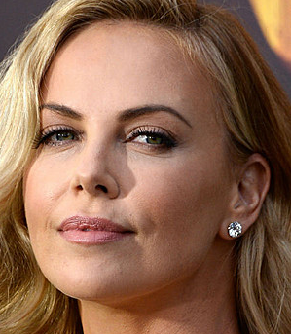
Now we know why the following Hollywood Stars are popular
Q7. What has Stars to do about ones Social Likeability?
Inference I

Slide 21
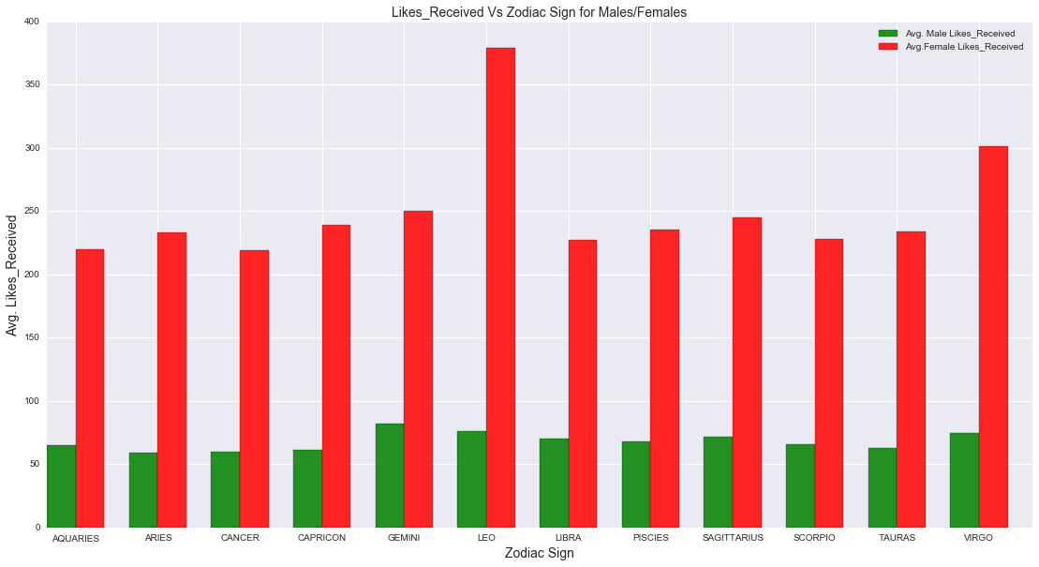
Q7. What has Stars to do about ones Social Likeability?
Leo Females are gets the most like in Facebook

